Slide 1
Section 8.1
Tangents and Circles
© Copyright all rights reserved to Homework depot: www.BCMath.ca

Slide 2
i) Review
Pythagorean Theorem:
  Right Triangles
Ex: Given each triangle, find the length of the missing side:
Site for Proving
Pythagorean Theorem
© Copyright all rights reserved to Homework depot: www.BCMath.ca

Slide 3
Pythagorean Triples
  A group of 3 integers that satisfy the Pythagorean formula
  Ie: (3 ,4, 5) (5, 12, 13) ….
Site for Generating
Pythagorean Triples
Practice: find the length of the missing sides:
© Copyright all rights reserved to Homework depot: www.BCMath.ca

Slide 4
I) What is a Tangent?
A tangent is a line that intersects a circle at exactly one point
Tangent
Point of Tangency
Not a Tangent!!
Not a Tangent!!
Not a Tangent!!
© Copyright all rights reserved to Homework depot: www.BCMath.ca

Slide 5
II) Naming tangents
When naming tangents or any line segment, use the letters at the endpoints
The line from point “A” to “C”
is called a tangent:
Ex: Name all the tangents in the diagram above:
The purple line is also a tangent:
The red tangent is called:
The green tangent is called:

Slide 6
II) Properties of a Tangent
A tangent is perpendicular to the circle radius at the point of tangency
If AC is a tangent line at point “B” then
Triangle ABO and Triangle OBC are both
right triangles!!
Angle OBA and OBC are both 90 degrees
© Copyright all rights reserved to Homework depot: www.BCMath.ca

Slide 7
Two tangents from the same exterior point to a circle are equal in length
Point “C” is the Exterior Point
Exterior
Point
© Copyright all rights reserved to Homework depot: www.BCMath.ca

Slide 8
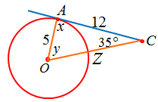
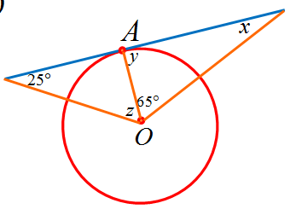
Ex: Find the missing values
© Copyright all rights reserved to Homework depot: www.BCMath.ca

Slide 9
Ex: Find the value of the “X”
© Copyright all rights reserved to Homework depot: www.BCMath.ca

Slide 10
Practice: Find the Missing Sides
Given:
© Copyright all rights reserved to Homework depot: www.BCMath.ca

Slide 11
Homework:
P388 #3 – 14, 17
© Copyright all rights reserved to Homework depot: www.BCMath.ca

